Slide 1
Advanced Pentaho Data Integration
James O’Reilly

Slide 2
Agenda
Metadata Injection
PDI as a Data Source
Data Streaming
Scalability
Project Management

Slide 3
Pentaho Data Integration Data Streaming
Messaging Systems - Mosquitto & Kafka
James O’Reilly

Slide 4
Agenda
MQTT - Mosquitto
Kafka

Slide 5
Overview of Messaging Systems

Slide 6
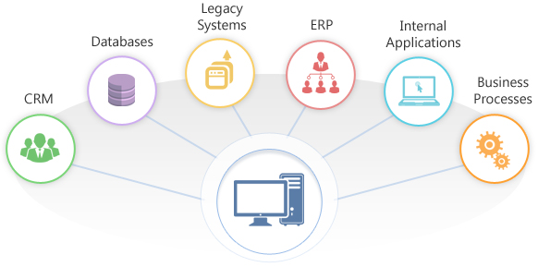
Overview of Messaging Systems
The goal of any Enterprise Integration is to establish unification between separate applications to achieve a consolidated set of functionalities.

Slide 7
Overview of Messaging Systems
Messaging systems can be used as an integration channel for information exchange between different applications
Loose coupling between applications ensures minimal dependencies on each other. This ensures that any changes in one application do not affect other applications.
Common interface definitions ensure a common agreed-upon data format for exchange between applications.
Latency is the time taken by messages to traverse between the sender and receiver.
Reliability ensures that temporary unavailability of applications does not affect dependent applications that need to exchange information.

Slide 8
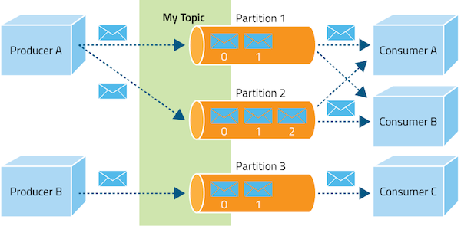
Overview of Messaging Systems
In a Publisher / Producer – Subscriber / Consumer model
A Subscriber registers its interest in a particular topic or event and is subsequently notified about the event asynchronously.
These events are generated by Publishers.

Slide 9
Overview of Messaging Systems
Some key features of a Messaging System:
Messages are shared through a channel called a Topic.
A Topic is a centralized place where producers can publish, and subscribers can consume, messages.
Messages delivered to a Topic are automatically pushed to all qualified Consumers.
There is no coupling of the Producers to the Consumers. Subscribers and Publishers can be added dynamically at runtime, which allows the system to grow or shrink in complexity over time.

Slide 10
MQTT - Mosquitto

Slide 11
MQTT - Mosquitto
MQTT stands for MQ Telemetry Transport.
It is a publish/subscribe, extremely simple and lightweight messaging protocol, designed for constrained devices and low-bandwidth, high-latency or unreliable networks.
Transportation
Smart Home
IoT
Healthcare Applications

Slide 12
MQTT - Mosquitto
The key component in MQTT is the MQTT broker.
The main task of MQTT broker is dispatching messages to the clients (“subscribers”).
In other words, it receives messages from publisher and dispatches these messages to the subscribers. While it dispatches messages, the MQTT broker uses the Topic to filter the clients that will receive the message.
The Topic is a string, and it is possible to combine the topics creating topic levels.

Slide 13
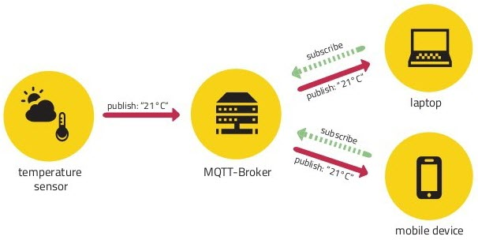
MQTT - Mosquitto
A Topic is like a virtual channel that connects a Publisher to its Subscribers.
Through this virtual channel, the Publisher is decoupled from the Subscribers, and the clients (Publishers or Subscribers) do not have to know each other.

Slide 14
MQTT – Use Cases
Caterpillar collected sensor data from fleets of ships transported via wireless networks and processed and fed the data to predictive models that resulted in annual maintenance cost savings of over $800K per ship and several million dollars across the entire fleet.
Hitachi Rail Europe received 3.6 million data points per second from its train sensors. Hitachi Vantara collected the train sensor data and passed it to predictive models to produce a variety of reports and ad hoc analysis that reduced transportation costs by over £20M.
IMS processed and fed telemetry data to predictive models for reports and analysis. The categorization of customer profiles resulted in IMS recommending the most optimal insurance offering to customers, improving customer acquisition and retention rates.

Slide 15
Guided Demo: MQTT
In this guided demonstration, you will configure and start a Mosquitto MQTT Broker on a Windows OS
Start the Mosquitto Service
Create Topics
Send some messages
Test a Multi-Broker Cluster
MQTT.fx

Slide 16
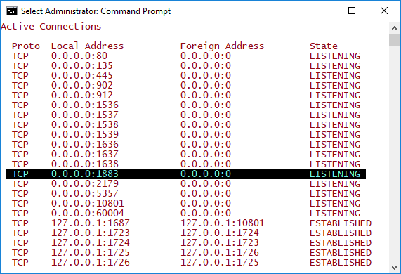
Guided Demo: MQTT
Mosquitto Broker has been installed as a service
Open command line:
netstat -an

Slide 17
Guided Demo: MQTT
To Subscribe to a Topic: test
Open another new command prompt in the location
C:\Mosquitto>
Type following command and hit Enter:
mosquitto_sub -t test

Slide 18
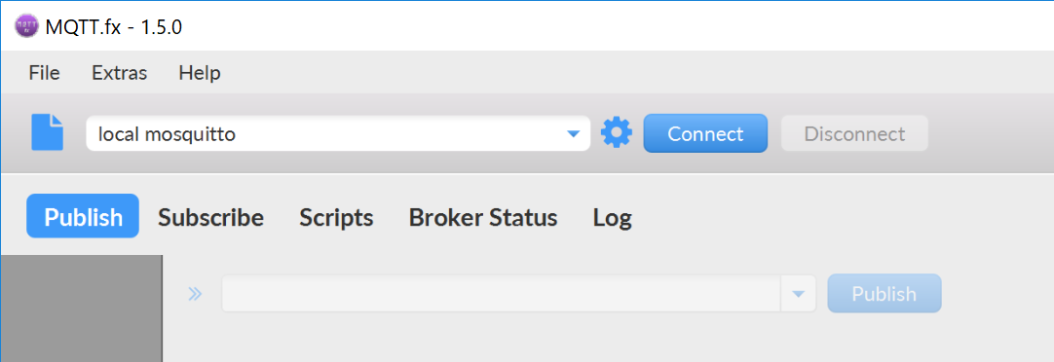
MQTT.fx
MQTT.fx is a MQTT Client written in Java based on Eclipse Paho.

Slide 19
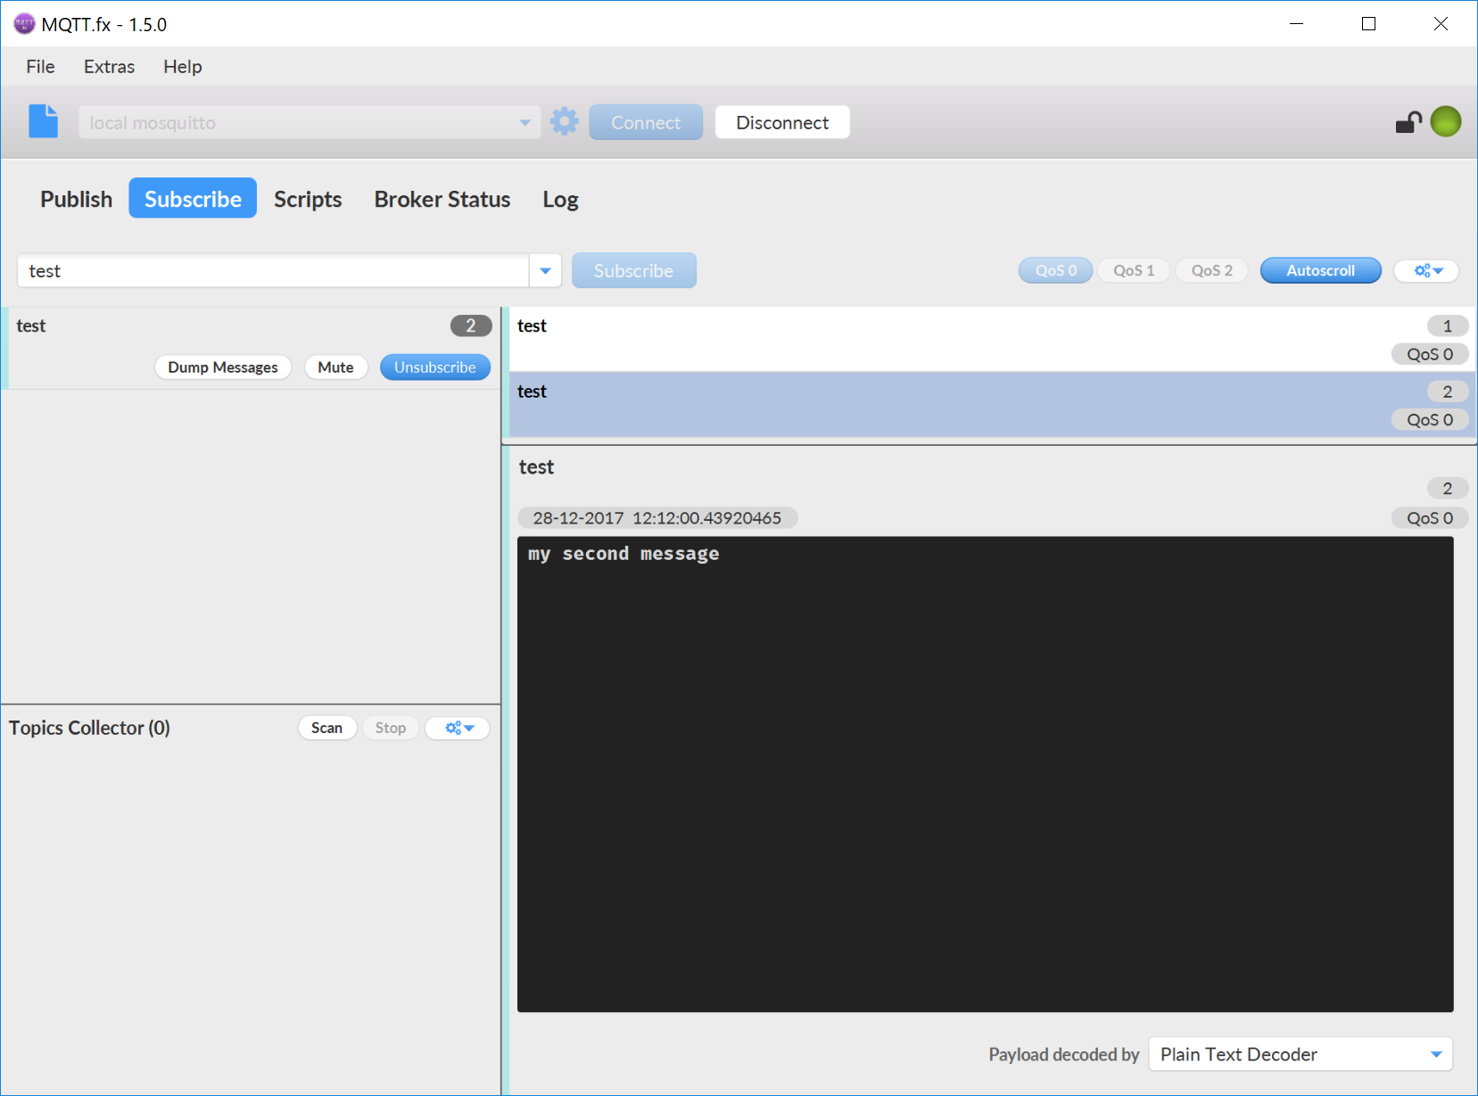
Guided Demo: MQTT.fx
Connect to the Mosquitto Broker
Publish / Subscribe to a Test Topic

Slide 20
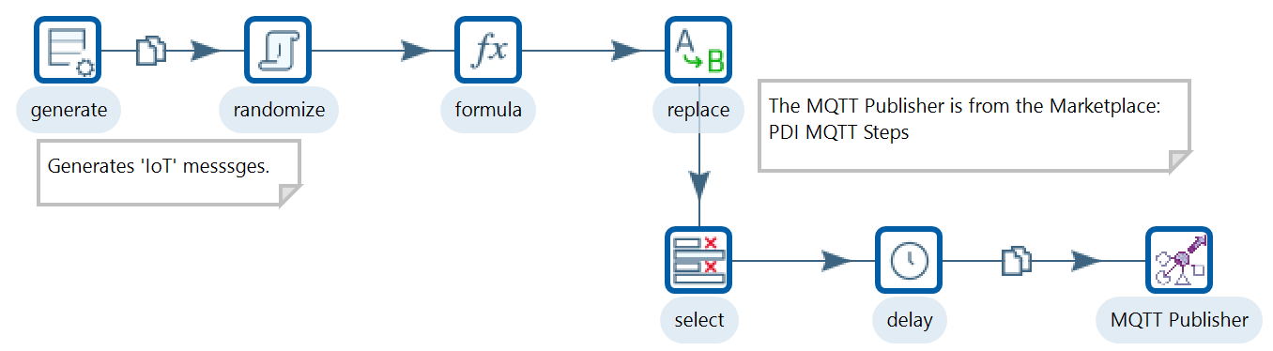
Guided Demo: MQTT - IoT
Track GPS co-ordinates
Open the Transformation:
C:\Pentaho Training\DI 1500 - Advanced PDI\Module 3 - Data Streaming\Lesson 3 - MQTT\Exercise – IoT\tr_iot_device_emulator.ktr

Slide 21
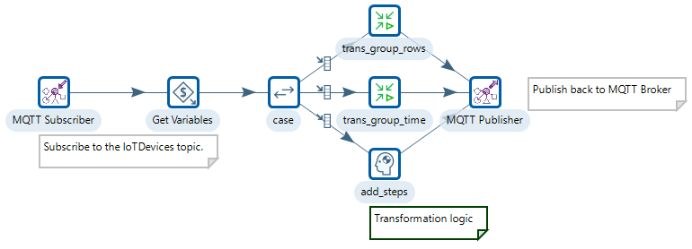
Guided Demo: MQTT - IoT
With this Transformation you ‘Subscribe’ to the IoT topic, conduct some PDI transformation Logic and finally ‘Publish’ back to the MQTT Broker
Open the Transformation:
C:\Pentaho Training\DI 1500\Module 3 - Data Streaming\Lesson 3 - MQTT\Exercise – IoT\tr_datastream.ktr

Slide 22
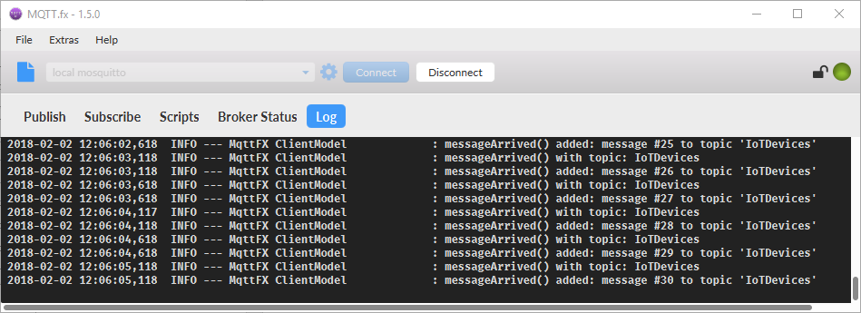
Guided Demo: MQTT - IoT
Run the Transformation:
tr_iot_device_emulator.ktr
Open MQTT.fx
Subscribe to Topic: IoTDevices
Run the Transformation:
tr_datastream.ktr
Subscribe to PDIDatastream

Slide 23
Kafka

Slide 24
Overview of Kafka
Kafka is a distributed Producer / Consumer messaging system which integrates applications / data streams.
Kafka is designed to deliver three main advantages over low-level Messaging Systems
Highly Reliable: Kafka replicates data and it can support multiple subscribers. In the event of failure, it automatically balances consumers in the event of failure which is very much reliable in comparison to similar messaging services.
Superbly Scalable: Kafka, which is a distributed system, is able to scale quickly and easily without incurring any downtime.

Slide 25
Overview of Kafka
Kafka is designed to deliver three main advantages over low-level Messaging Systems
High Performance: For both publishing and subscribing, Kafka delivers high throughput. It is capable of offering constant levels of performance even when it deals with many terabytes of stored messages.
Durable: Kafka provides intra-cluster replication by keeping messages on the disks which make it durable messaging system.

Slide 26
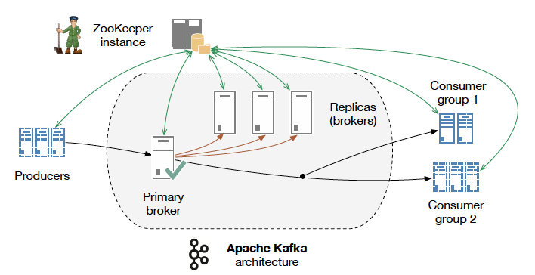
Overview of Kafka
Kafka Architecture

Slide 27
Overview of Kafka
Broker - Kafka cluster typically consists of multiple brokers to maintain load balance. Kafka brokers are stateless, so they use ZooKeeper for maintaining their cluster state.
ZooKeeper - ZooKeeper is used for managing and coordinating Kafka broker.
Producers - Producers push data to brokers.
Consumers - Since Kafka brokers are stateless, which means that the consumer must maintain how many messages have been consumed by using partition offset.

Slide 28
Overview of Kafka
In a Publisher / Producer – Subscriber / Consumer model
A Subscriber registers its interest in a particular topic or event and is subsequently notified about the event asynchronously.
These events are generated by Publishers.

Slide 29
Guided Demo: Kafka commands
In this demo you’re going to enter the most common commands
Start Servers
Create Topics
Send Messages (Producer / Consumer)
Kafka Tool

Slide 30
Kafka Connect

Slide 31
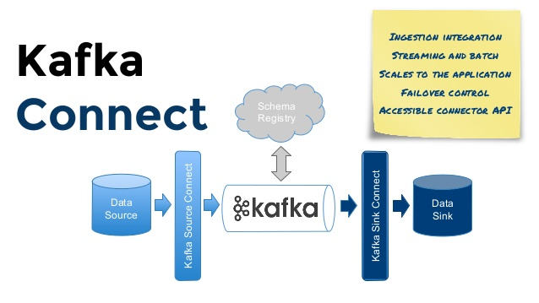
Kafka Connect
Kafka Connect is a framework for streaming data between Apache Kafka and other data systems.
Connect makes it simple to use existing connector implementations for common data sources and sinks to move data into and out of Kafka. Kafka Connect’s applications are wide ranging.

Slide 32
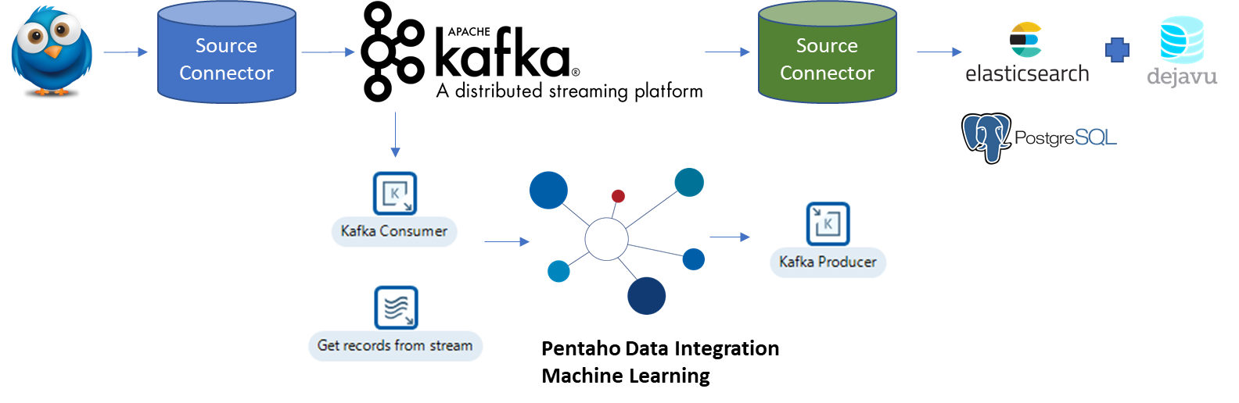
Guided Demo: Kafka Connect -Twitter
So its time to put it all together..!
You will need a Twitter account..

Slide 33

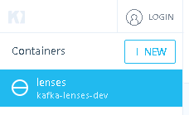
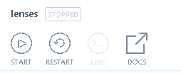
Guided Demo: Kafka Connect -Twitter
Ensure you have your Twitter API keys ..
Start Docker
Start Lenses container

Slide 34
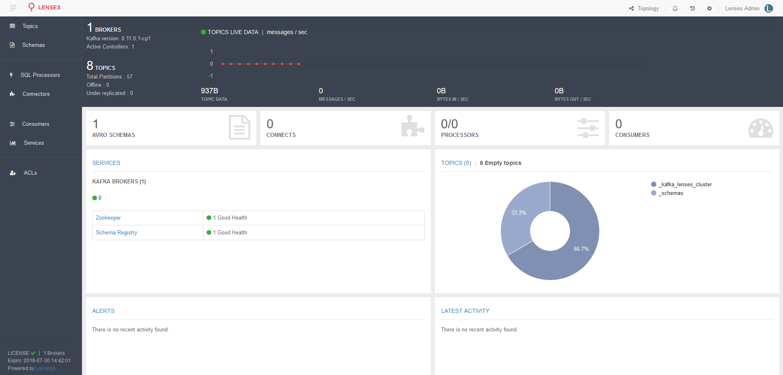
Guided Demo: Kafka Connect -Twitter
Lenses dashboard

Slide 35
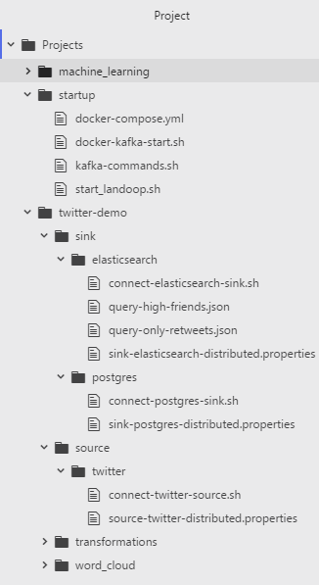
Guided Demo: Kafka Connect -Twitter
Project Folder
startup script for Docker Windows
Source / Sink Connector properties

Slide 36
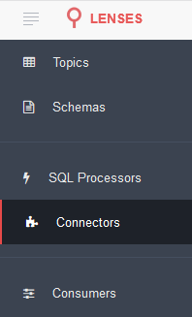

Guided Demo: Kafka Connect -Twitter
Open Connectors .. This may take a few minutes to load..
Click on New Connector
In Source section select Twitter

Slide 37
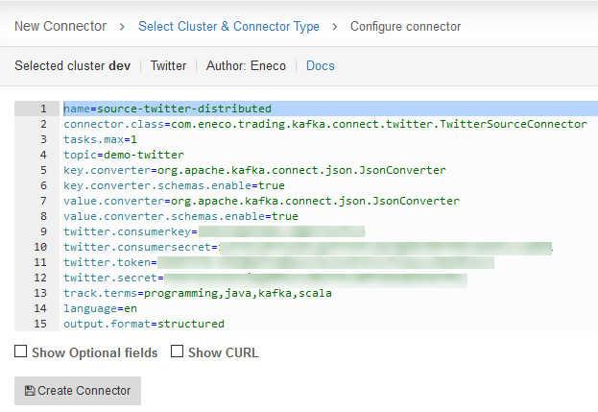
Guided Demo: Kafka Connect -Twitter
Replace the script with the script you saved in:
source-twitter-distributed.properties

Slide 38
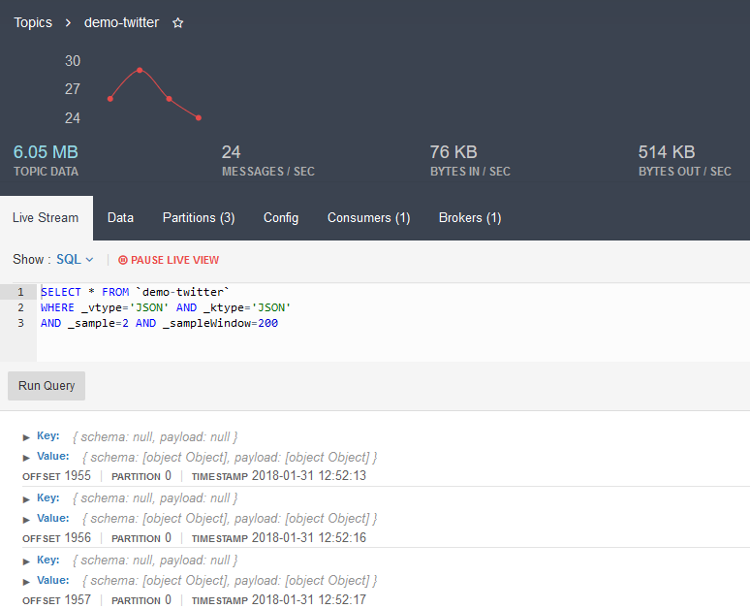
Guided Demo: Kafka Connect -Twitter
Live Tweets will now be streamed into Kafka..
Expand Value Key

Slide 39
Pentaho Kafka Producer / Consumer

Slide 40
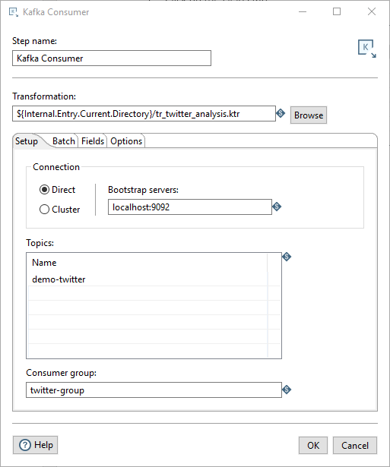
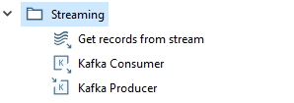
Guided Demo: Pentaho Kafka Consumer
Configure Kafka Consumer step

Slide 41
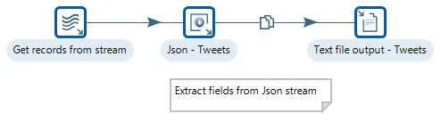
Guided Demo: Pentaho Kafka Stream
Twitter data is now streaming nicely to PDI as a Json stream. The next involves is to parse the Json stream and map to PDI data fields.

Slide 42
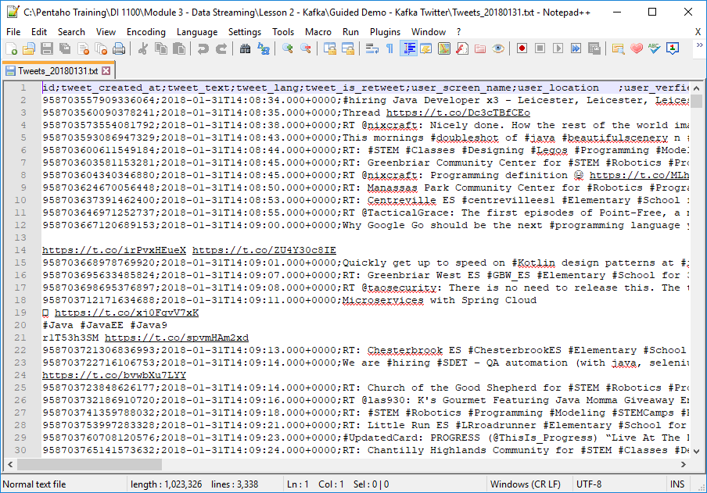
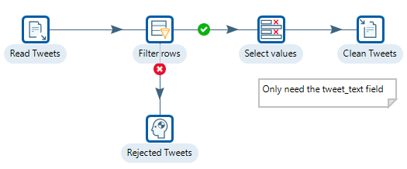
Guided Demo: Clean Tweets
One of the problems is the quality of the twitter stream data.

Slide 43
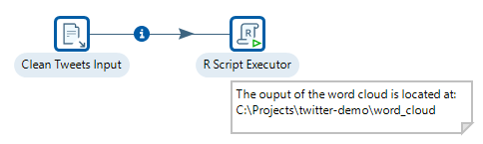
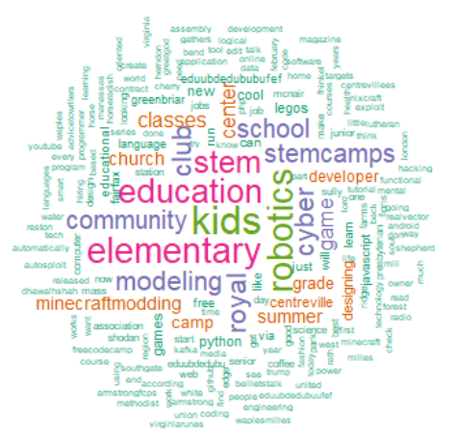
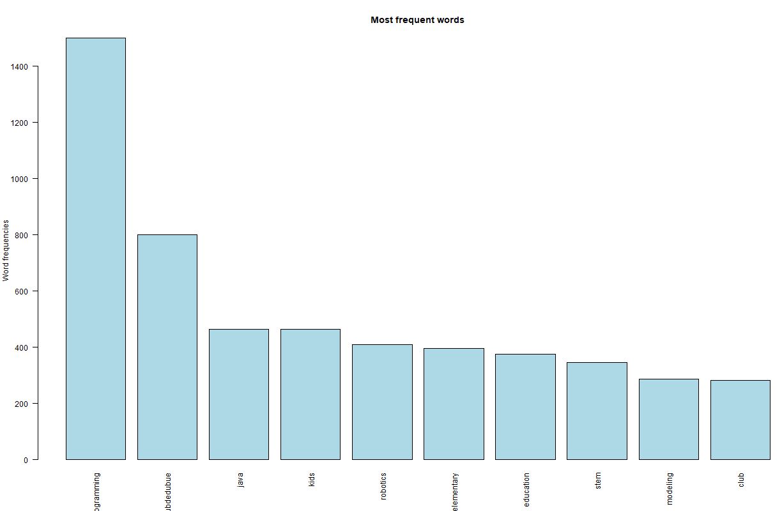
Guided Demo: Word Cloud
Text mining methods allow us to highlight the most frequently used keywords in a paragraph of texts.

Slide 44
Summary

Slide 45
Summary
MQTT - Mosquitto
Kafka

Slide 46
Thank You

